Slide 1
Escape from the Ronan II
Johnathan Hinebrook

Slide 2
Story
“You are the caption of a once great battleship that has been stripped down and turned into a cargo ship.
One day you are offered the transport job of a life time. The reward is high enough to live comfortably for the rest you life.
Naturally you accept. Little do you know this will be your last job in the Ronan.”

Slide 3





Characters
Character | Description | Image
Player | Owner of the Ronan II
Vofa | Owner of Cargo
Scavengers

Slide 4
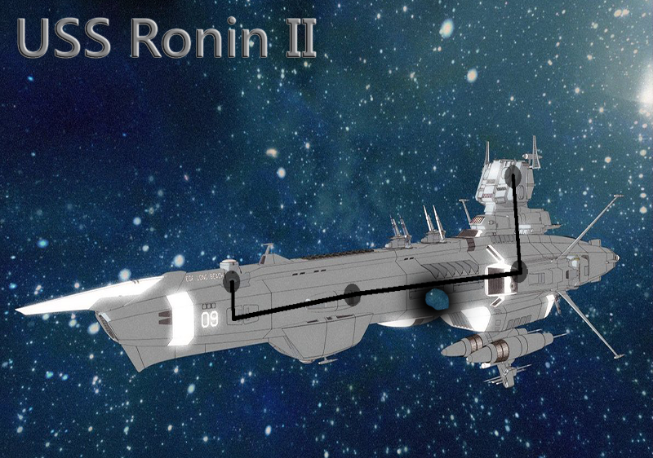
Game Map

Slide 5
Contract
3 unique levels
1 song
JRPG inspired battle engine.

Slide 6
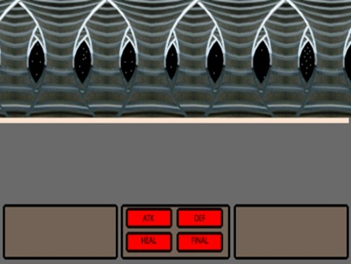
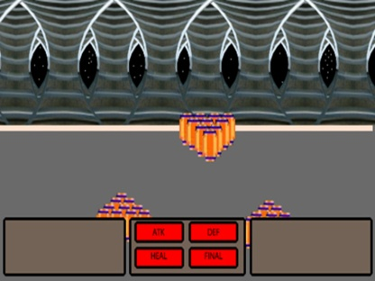
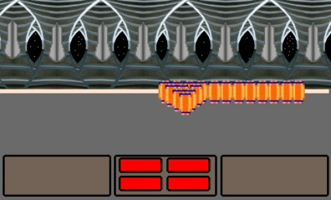
Three Unique Levels
Levels | Mobs

Slide 7


One Song
Song
FFVII Battle Music
FFVII Fanfare

Slide 8
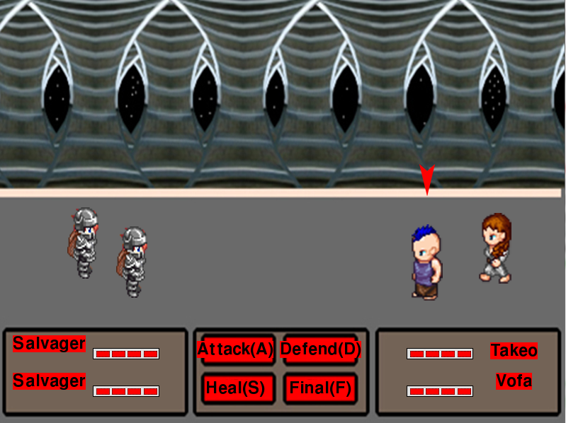
JRPG styled battle engine

Slide 9
Why invest
JRPGs are a solid investment

